Slide 1
Mass, Momentum, and Energy transfer from the ionosphere to the magnetosphere
(role of molecular/heavy/metallic ions)
Mass: by knowing composition of ionospheric ions (N₂⁺/N⁺, N⁺/O⁺, Fe⁺/O⁺) leaving the ionosphere, we
know production of these ions at the upper ionosphere, which is a combination of ion production/dissociation and upward convection/ion flow.
can estimate the effect of ion outflow on the evolution of the Earth's atmosphere
can estimate the mass loading effect on the solar wind/magnetosphere coupling and turbulence
can estimate how quickly the space debris is fragmented into atomic level (we need separate Al=27/N₂ =28 mass range up to several hundred) and how quickly the magnetosphere is polluted by these fragmented debris
Momentum/Energy: by knowing upward momentum/energy carried by ions and field respectively, we
know real reflection rates of the momentum/energy at the ionosphere for both particle and field
can estimate the effect of the ionospheric composition on such reflection rates
Understand "effect of small-scale ionospheric (cf. auroral, turbulence, etc) process on large-scale response/system" like greenhouse effect:
note: not mentioning Joule heating or space weather effect
Aiming F (as backup in case M goes to astrophysics or planetary): one SC (max add 1-2 microsat)
+ collaborate with Japanese FACTORS = 2SC x 400x4000 km with particle/wave/camera, earth 2030's
(if M-class, heavy ion is science can just be spin-off of main science)

Slide 2
Instruments and satellite for F class
Why F-class, if Earth mission?
M+F joint call means one astrophysics and one solar system
Most likely combinations are
M: astrophysics, F: Earth (planetary is not possible)
M: planetary, F: astrophysics
(ESA would reserve M class for planetary)
Instrument: ideally < 20 kg, and max < 30 kg
One SC (maximum additional nanosatellite provided externally, because no free launch like Comet Interceptor)
No EMC requirement: (field-instrument is similar level as cube-sat project)
Among plasma packages, heavy/metallic ion/neutral and dust have not been well studied during past magnetospheric mission => next two slides

Slide 3
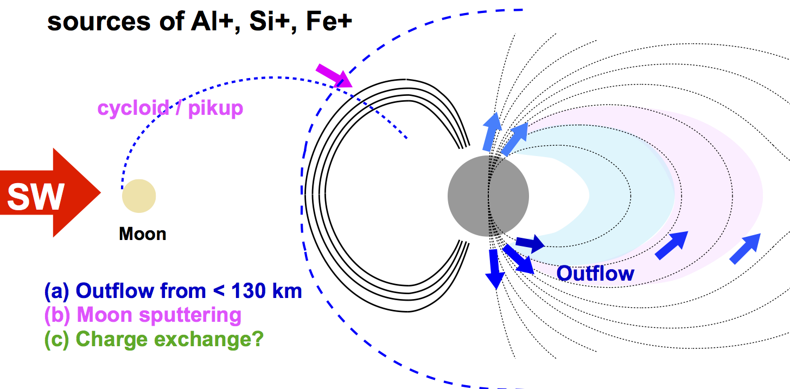
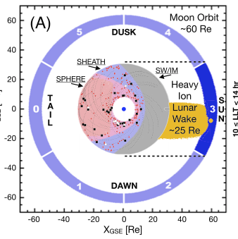
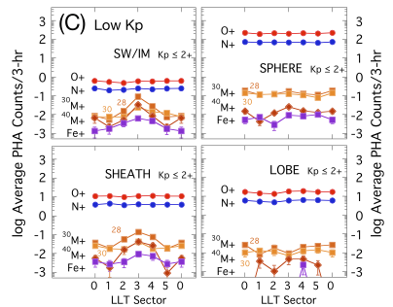
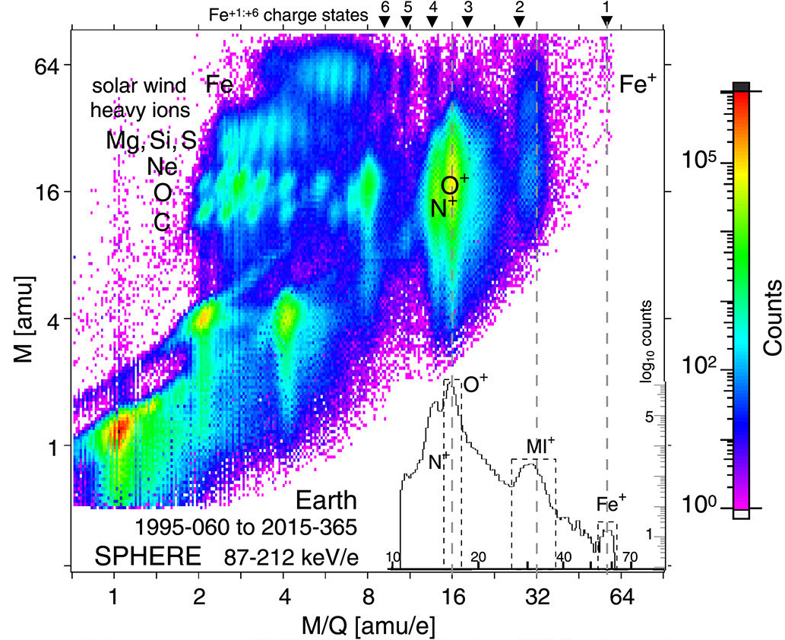
F mission (Earth):
We need argument for plasma measurements (against telescopes); e.g., must be urgent
(1) Source of metallic and molecular ions/neutrals is not known (2) Molecular ion escape keeps many information of ionospheric processes.

Slide 4
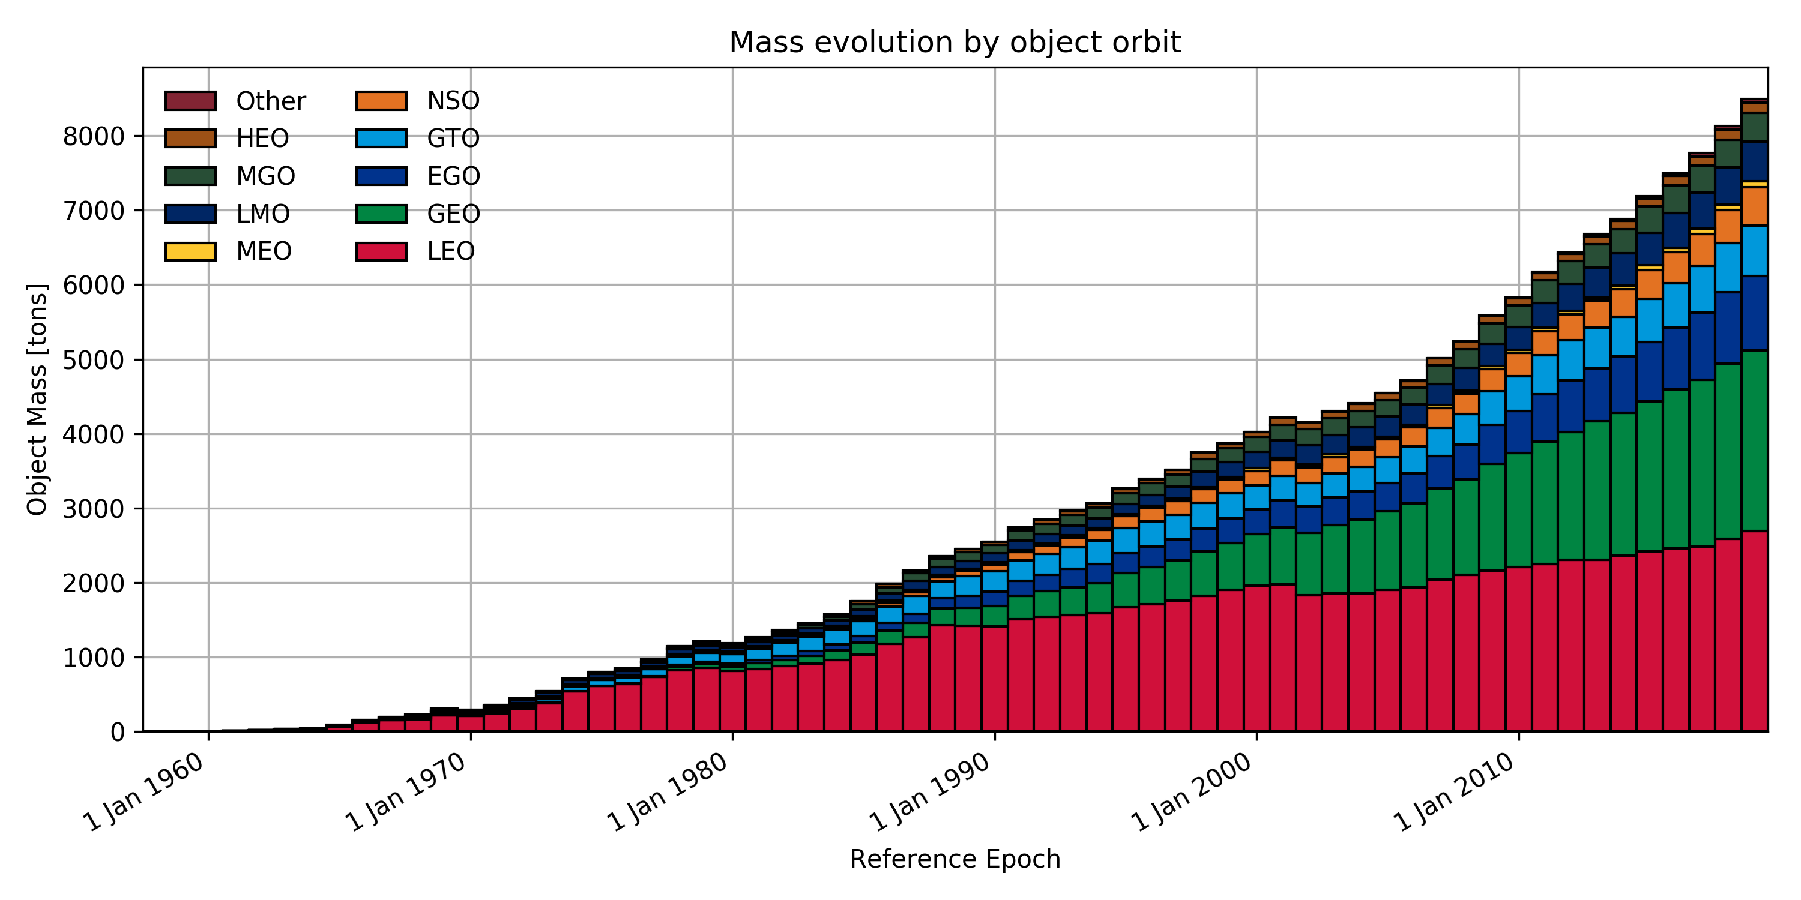
injecting mass [t/yr] of ablated elements into the atmosphere
Schulz and Glassmeier, 2021
Through outflow process of ions, metallic ions enters the magnetosphere, but amount is still unknown. Before man-made (debris origin) contaminate, we need to measure it.
https://www.esa.int/Safety_Security/Space_Debris

